Slide 1



Pauwan
THE PEOPLES HOSPITAL MANAGEMENT SYATEM
BY: PAUL WANJUKI
Telephone
November 2024
+254 735 143 953

Slide 2

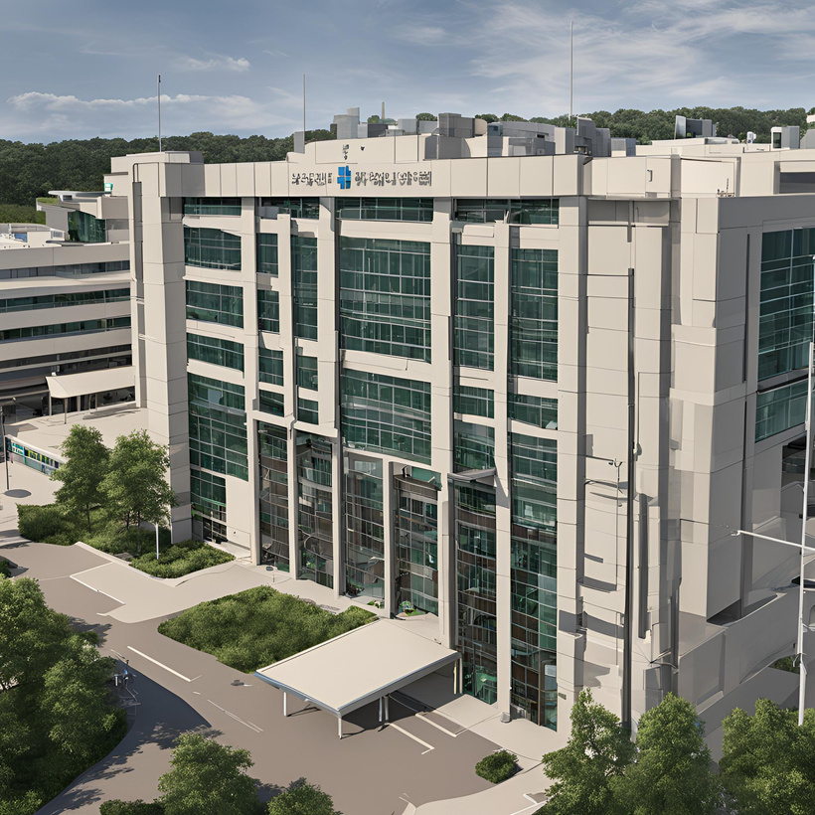

OVERVIEW
PITCH DECK PRESENTATION
01
06
Introduction
Functional Requirements
02
07
Problem Statement
System Architecture
03
Project Scope
08
Development Phases
04
Target Audience
09
Evaluation and Stability
05
10
Pauwan
Technical Overview
Conclusion

Slide 3

Pauwan
INTRODUCTION
GREETING FROM US
The Hospital Management System is a new platform designed to address the inefficiencies and security risks in current hospital operations. It offers a comprehensive solution for managing patient information, scheduling, billing, and administrative tasks, aiming to improve efficiency, reduce errors, and enhance patient care.
Thank you

Slide 4

Pauwan
PROBLEM STATEMENT
CHALLENGES IN HOSPITAL MANAGEMENT
Inefficient patient record management.
Long wait times and delayed services.
Fragmented data across multiple systems.
Difficulty in accessing historical data
Manual processes causing errors and inconsistencies.

Slide 5

Pauwan
SOLUTION OVERVIEW
A WEB-BASED HOSPITAL MANAGEMENT SYSTEM
Streamlines hospital operations with centralized data management.
Improves accessibility, accuracy, and efficiency.
Reduces manual paperwork and human error.
Provides a user-friendly platform for staff, patients, and administrators.

Slide 6

TARGET AUDIENCE
Small to Medium-Sized Hospitals.
Private Clinics and Specialty Care Centers.
Health Systems and Networks Seeking Digital Transformation.
Administrators and Healthcare IT Managers.
Healthcare Providers in Developing Regions.
Pauwan

Slide 7

Pauwan
TECHNICAL OVERVIEW
01
Operating Environment
Standard web browsers (Chrome, Firefox, Safari, Edge).
Desktop and mobile compatibility.
03
Key Features
02
Technologies Used
Comprehensive Patient Management.
Appointment Scheduling.
User Authentication.
Admin Dashboard.
Contact Management.
Backend: Node.js, Express.
Database: MySQL
Frontend: HTML, CSS, JavaScript.

Slide 8


FUNCTIONAL REQUIREMENT
Pauwan
KEY FUNCTIONALITIES
Interactive Homepage: Motto, Mission, vision, About Us, Schedules.
Services: Inpatient, Outpatient, Consultant Clinics, Cardiac Programs, Telemedicine.
Gallery Page: Photos, Videos.
Contact Us: Form.
Login: Login for members.
Sign In: Sign In for new members.
Admin: Administrators login.

Slide 9



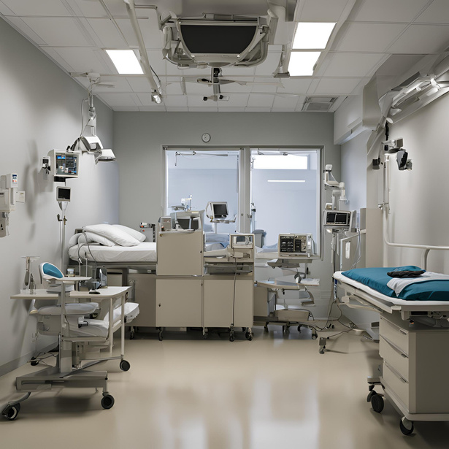

Pauwan
SYSTEM ARCHITECTURE
Client-Server Model
Frontend: js or similar framework.
Backend: Node.js, Express.
Database: MySQL.
01
ARCHITECTURE OVERVIEW
02
Database Design:
Key Tables: Users.

Slide 10

Content Development
Pauwan
01
02
Website Design
03
Technical Setup
DEVELOPMENT PHASES
04
Front-end Development
05
Back-end Development
06
Integration and Testing
07
Deployment and Maintenance

Slide 11
EVALUATION AND SUSTAINABILITY
Pauwan
Evalution Criteria
Website Traffic (Google Analytics)
Member Participation
User Feedback
Number of Partnerships
Sustainability Plan
Establish a management team.
Regular content and feature updates.
Ongoing technical support and maintenance.

Slide 12
Pauwan
Our Hospital Management System is a robust, user-friendly platform designed to streamline healthcare operations, reduce inefficiencies, and improve patient care.
With comprehensive features, secure data handling, and scalability, it offers an ideal solution for hospitals and clinics looking to modernize their systems affordably and effectively.
THANK YOU
FOR YOUR NICE ATTENTION
Telephone
November 2024
+254 735 143 953

